Slide 1

IT2060
Operating Systems and System Administration
Lecture 11
Virtual Memory Management

Slide 2
Background
Virtual memory – separation of user logical memory from physical memory
  Only part of the program needs to be in memory for execution
  Logical address space can therefore be much larger than physical address space
  Allows address spaces to be shared by several processes
  Allows for more efficient process creation
  More programs running concurrently
  Less I/O needed to load or swap processes

Slide 3
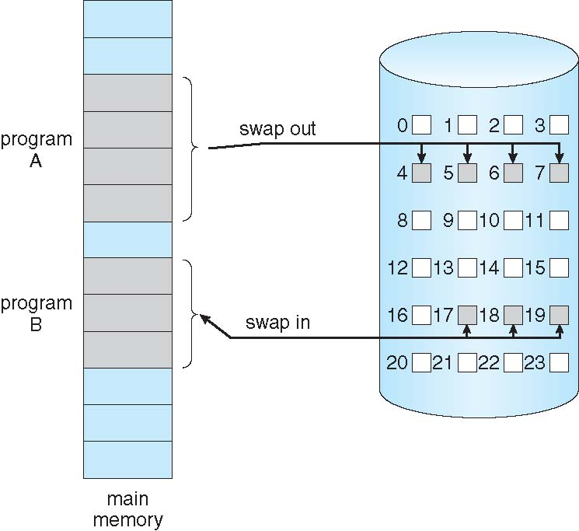
Demand Paging
Could bring entire process into memory at load time
Or bring a page into memory only when it is needed
  Less I/O needed, no unnecessary I/O
  Less memory needed
  Faster response
  More users
Similar to paging system with swapping (diagram on right)
Page is needed ⇒ reference to it
  invalid reference ⇒ abort
  not-in-memory ⇒ bring to memory
Lazy swapper – never swaps a page into memory unless page will be needed
  Swapper that deals with pages is a pager

Slide 4
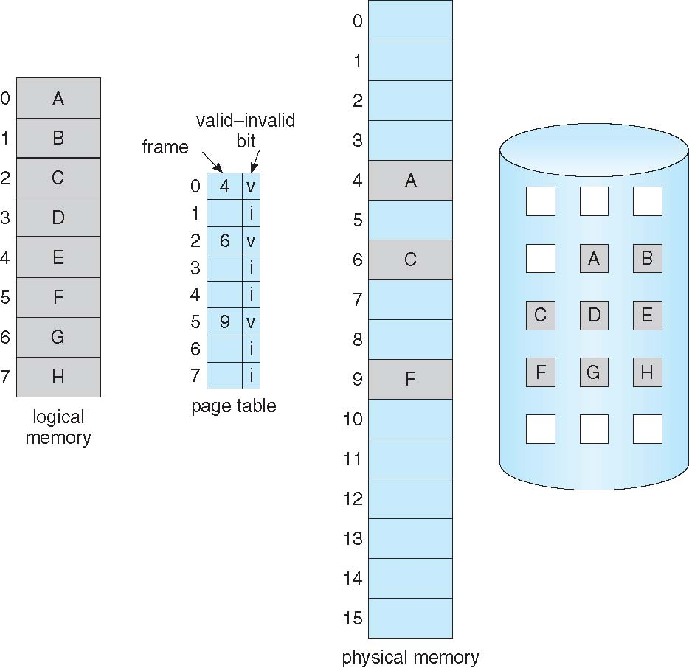
Page Table When Some Pages Are Not in Main Memory

Slide 5
Page Fault
If there is a reference to a page, first reference to that page will trap to operating system:
page fault
Operating system looks at another table to decide:
  Invalid reference ⇒ abort
  Just not in memory
Find free frame
Swap page into frame via scheduled disk operation
Reset tables to indicate page now in memory
Set validation bit = v
Restart the instruction that caused the page fault

Slide 6
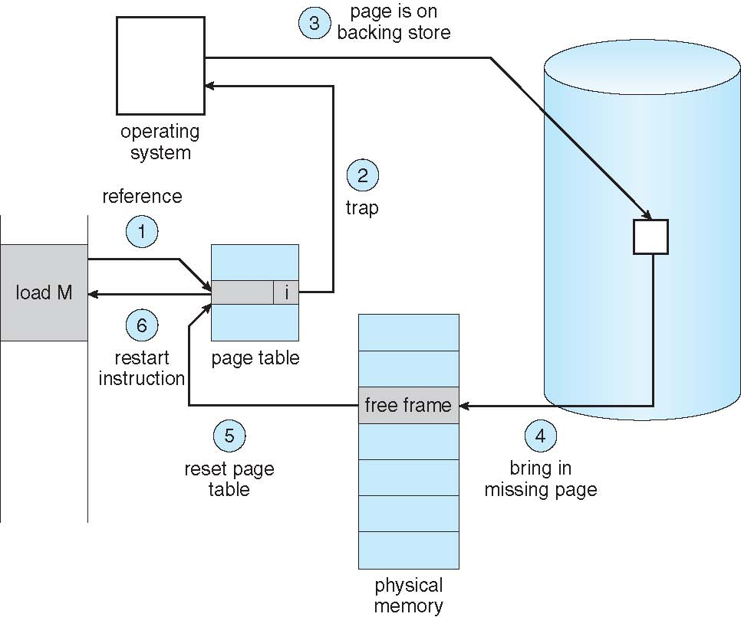
Steps in Handling a Page Fault

Slide 7
Performance of Demand Paging
Stages in Demand Paging (worse case)
Trap to the operating system
Save the user registers and process state
Determine that the interrupt was a page fault
Check that the page reference was legal and determine the location of the page on the disk
Issue a read from the disk to a free frame:
  Wait in a queue for this device until the read request is serviced
  Wait for the device seek and/or latency time
  Begin the transfer of the page to a free frame
While waiting, allocate the CPU to some other user
Receive an interrupt from the disk I/O subsystem (I/O completed)
Save the registers and process state for the other user
Determine that the interrupt was from the disk
Correct the page table and other tables to show page is now in memory
Wait for the CPU to be allocated to this process again
Restore the user registers, process state, and new page table, and then resume the interrupted instruction

Slide 8
Basic Page Replacement
Find the location of the desired page on disk
Find a free frame:
- If there is a free frame, use it
- If there is no free frame, use a page replacement algorithm to select a victim frame
- Write victim frame to disk if dirty
Bring the desired page into the (newly) free frame; update the page and frame tables
Continue the process by restarting the instruction that caused the trap
Note now potentially 2 page transfers for page fault – increasing EAT

Slide 9
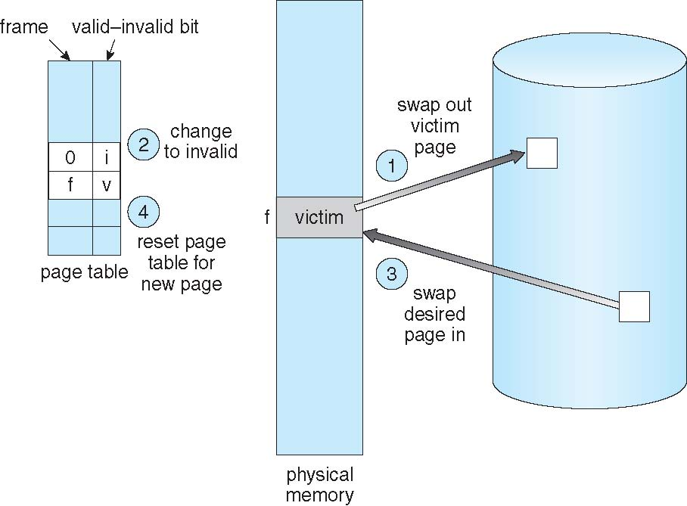
Page Replacement

Slide 10
Page-replacement algorithms
There are many page replacement algorithms
  We want an algorithm that results in the lowest page-fault rate.
Evaluate algorithm by running it on a particular string of memory references (reference string) and compute the number of page faults on that string.
Reference string can be generated
  by random number generator (artificial) or
  by tracing a given system and recording the address of each memory reference.
Example:
Consider the following memory address sequence:
    0100, 0432, 0101, 0612, 0102, 0103, 0104, 0101, 0611, 0102, 0103, 0104, 0101, 0610, 0102, 0103, 0104, 0101, 0609, 0102, 0105.
If system’s page size = 100 bytes, we have the following page reference string: 1, 4, 1, 6, 1, 6, 1, 6, 1, 6, 1
To determine the number of page faults for a particular reference string and page-replacement algorithm, we need to know the total number of frames available.

Slide 11
First-in-first-out (FIFO) algorithm
The simplest page-replacement algorithm.
  Use FIFO queue: replace the page at the head of the queue, and insert a new page at the tail.
FIFO replacement suffers from Belady’s anomaly
  More frames result in more page faults – an anomaly!
Examples: reference string: 1, 2, 3, 4, 1, 2, 5, 1, 2, 3, 4, 5
3 or 4 frames (3 or 4 pages can be in memory at a time per process)
1
2
3
4
5
4
1
2
3
4
5
10 page faults
9 page faults
1
5
1
3
2
2
4
3

Slide 12


Slide 13
Least recently used (LRU) algorithm
LRU replaces the page that has not been used for the longest period of time.
  Associate each page with its last use
  It has good performance, and is often used
  It does not suffer from Belady’s anomaly
A class of algorithms that do no suffer from Belady’s anomaly are called stack algorithms.
  In a stack algorithm, the set of pages in memory for n frames is always a subset of the set of pages that would be in memory with n+1 frames.
Reference string: 1, 2, 3, 4, 1, 2, 5, 1, 2, 3, 4, 5
1
2
3
4
5
8 page faults
5
4
3

Slide 14


Slide 15

Optimal page replacement algorithm (OPT)
OPT replaces page that will not be used for the longest period of time
For a fixed number of frames, OPT has the lowest page fault rate of all algorithms
  It also never suffers from Belady’s anomaly.
4 frames example: 1, 2, 3, 4, 1, 2, 5, 1, 2, 3, 4, 5
1
2
3
4
4
6 page faults
Problem: It is difficult to implement
  It requires future knowledge of the reference string!
This algorithm is used mainly to measure how well a new algorithm performs
5

Slide 16


Slide 17
Page-Buffering Algorithms
Keep a pool of free frames, always
  Then frame available when needed, not found at fault time
  Read page into free frame and select victim to evict and add to free pool
  When convenient, evict victim
Possibly, keep list of modified pages
  When backing store otherwise idle, write pages there and set to non-dirty
Possibly, keep free frame contents intact and note what is in them
  If referenced again before reused, no need to load contents again from disk
  Generally useful to reduce penalty if wrong victim frame selected

Slide 18
End of Lecture 11

